Slide 1
Configuración de hiperparametros

Slide 2
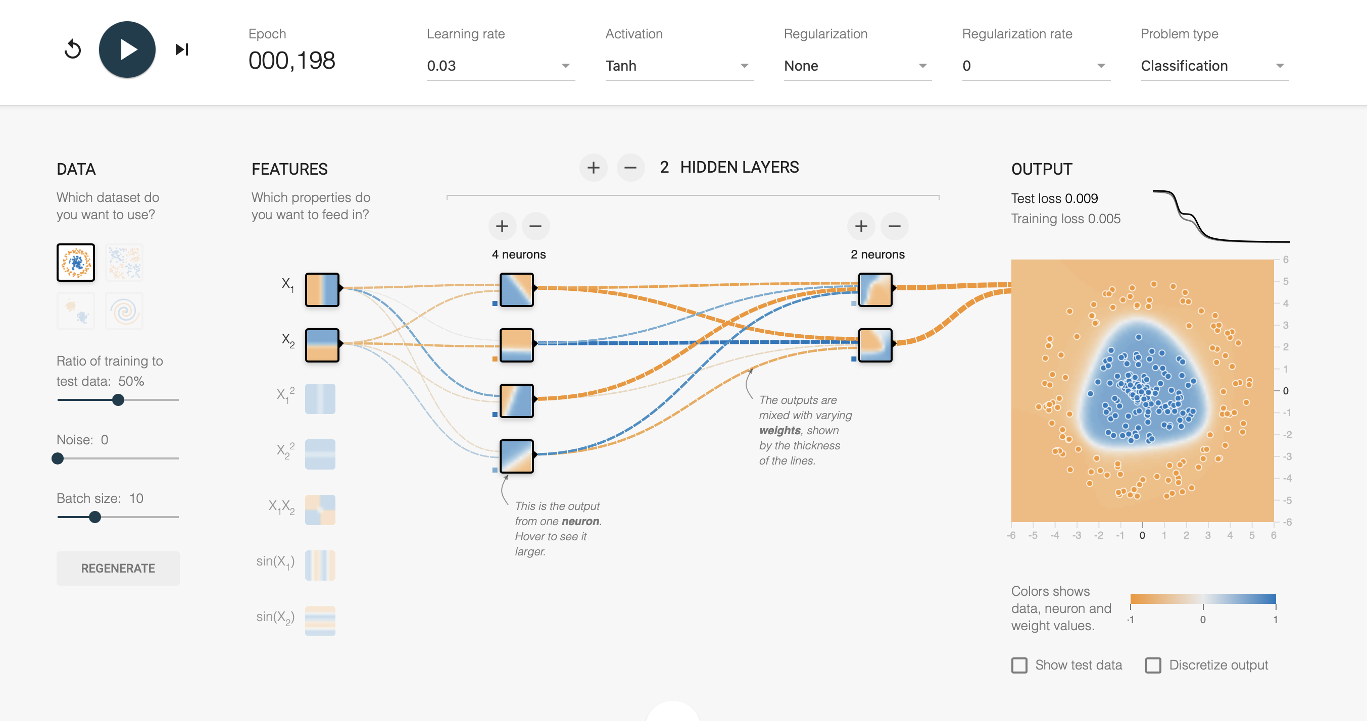
Hiperparametros: Epoch= 000.198 learning rate=0.03 Activation=Tanh Regularization=none Regularization rate=0 Hidden layers= 2 1 hidden layers=4 2 hidden layers=2 Test los 0.009

Slide 3
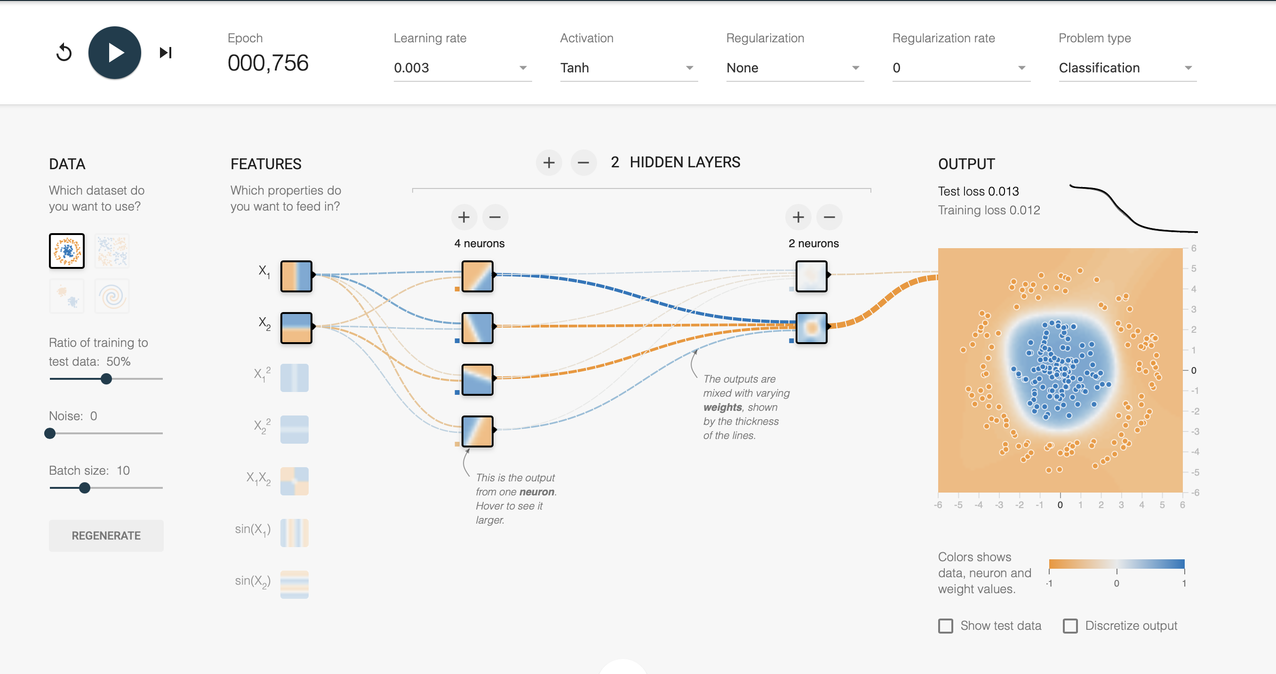
Hiperparametros: Epoch= 000.756 learning rate=0.003 Activation=Tanh Regularization=none Regularization rate=0 Hidden layers= 2 1 hidden layers=4 2 hidden layers=2 Test los 0.013

Slide 4
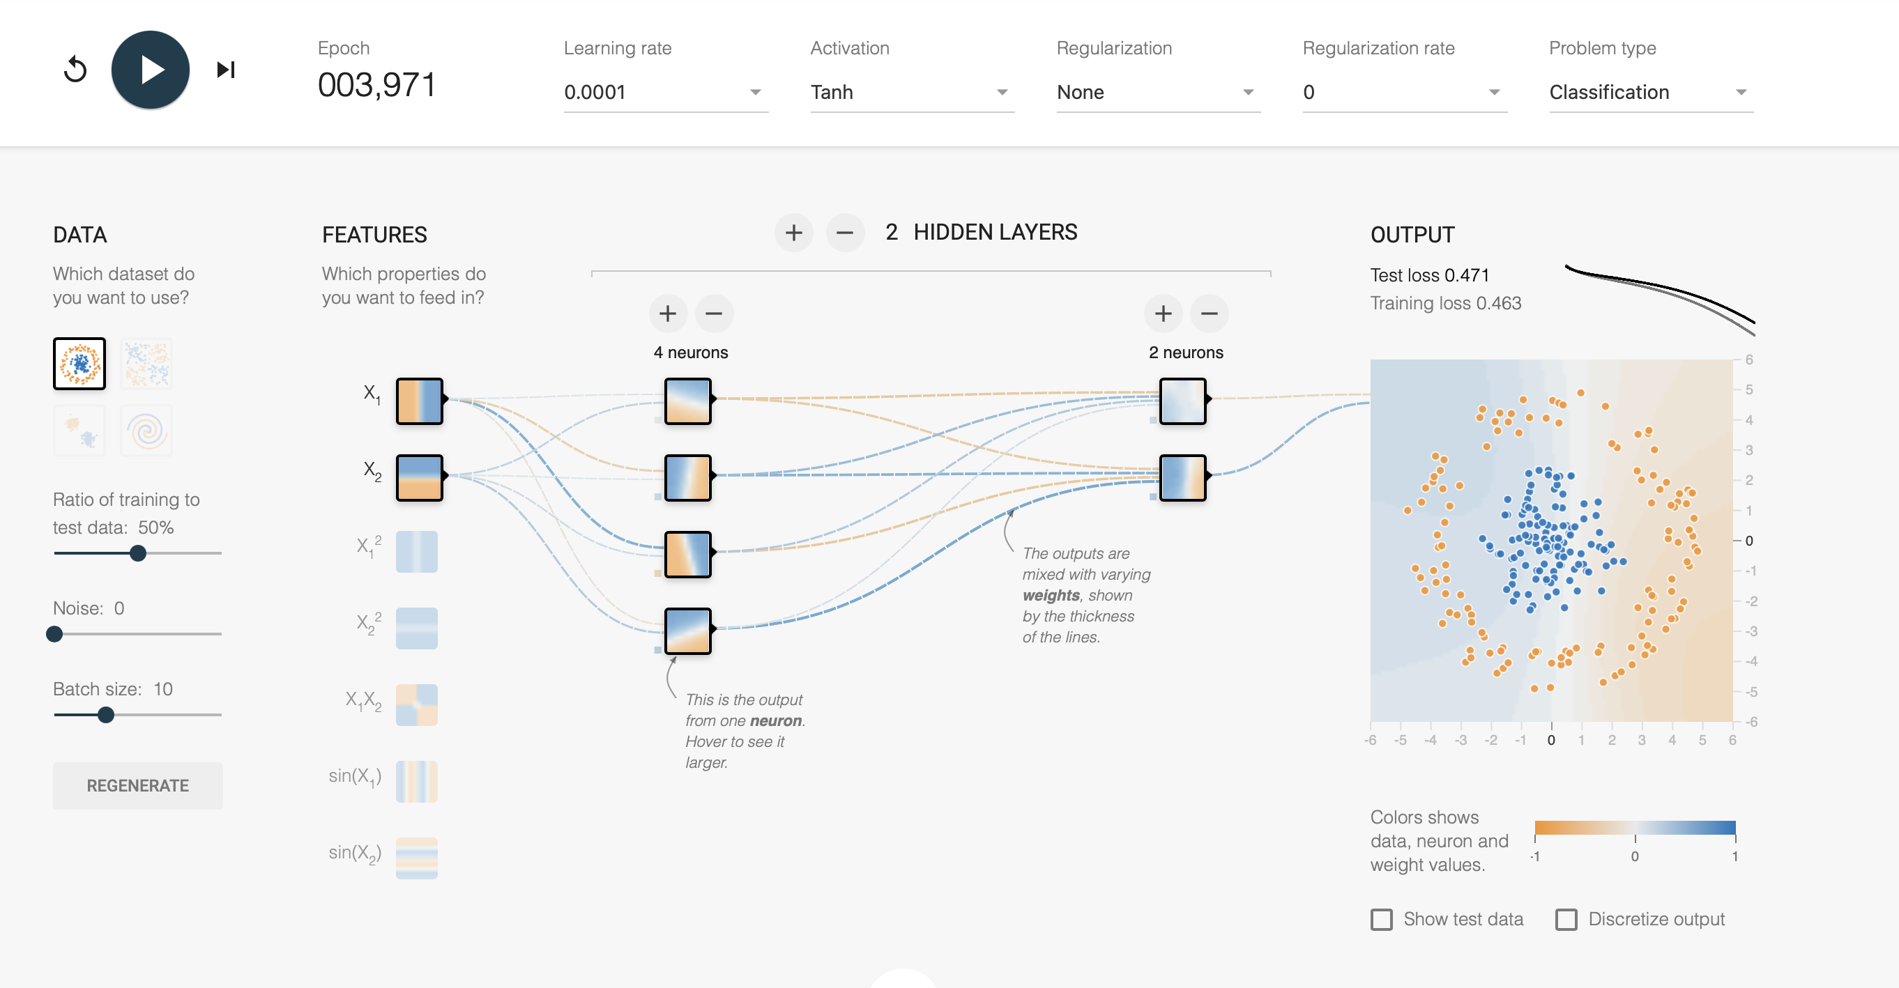
Hiperparametros: Epoch= 0003.971 learning rate=0.0001 Activation=Tanh Regularization=none Regularization rate=0 Hidden layers= 2 1 hidden layers=4 2 hidden layers=2 Test los 0.471

Slide 5
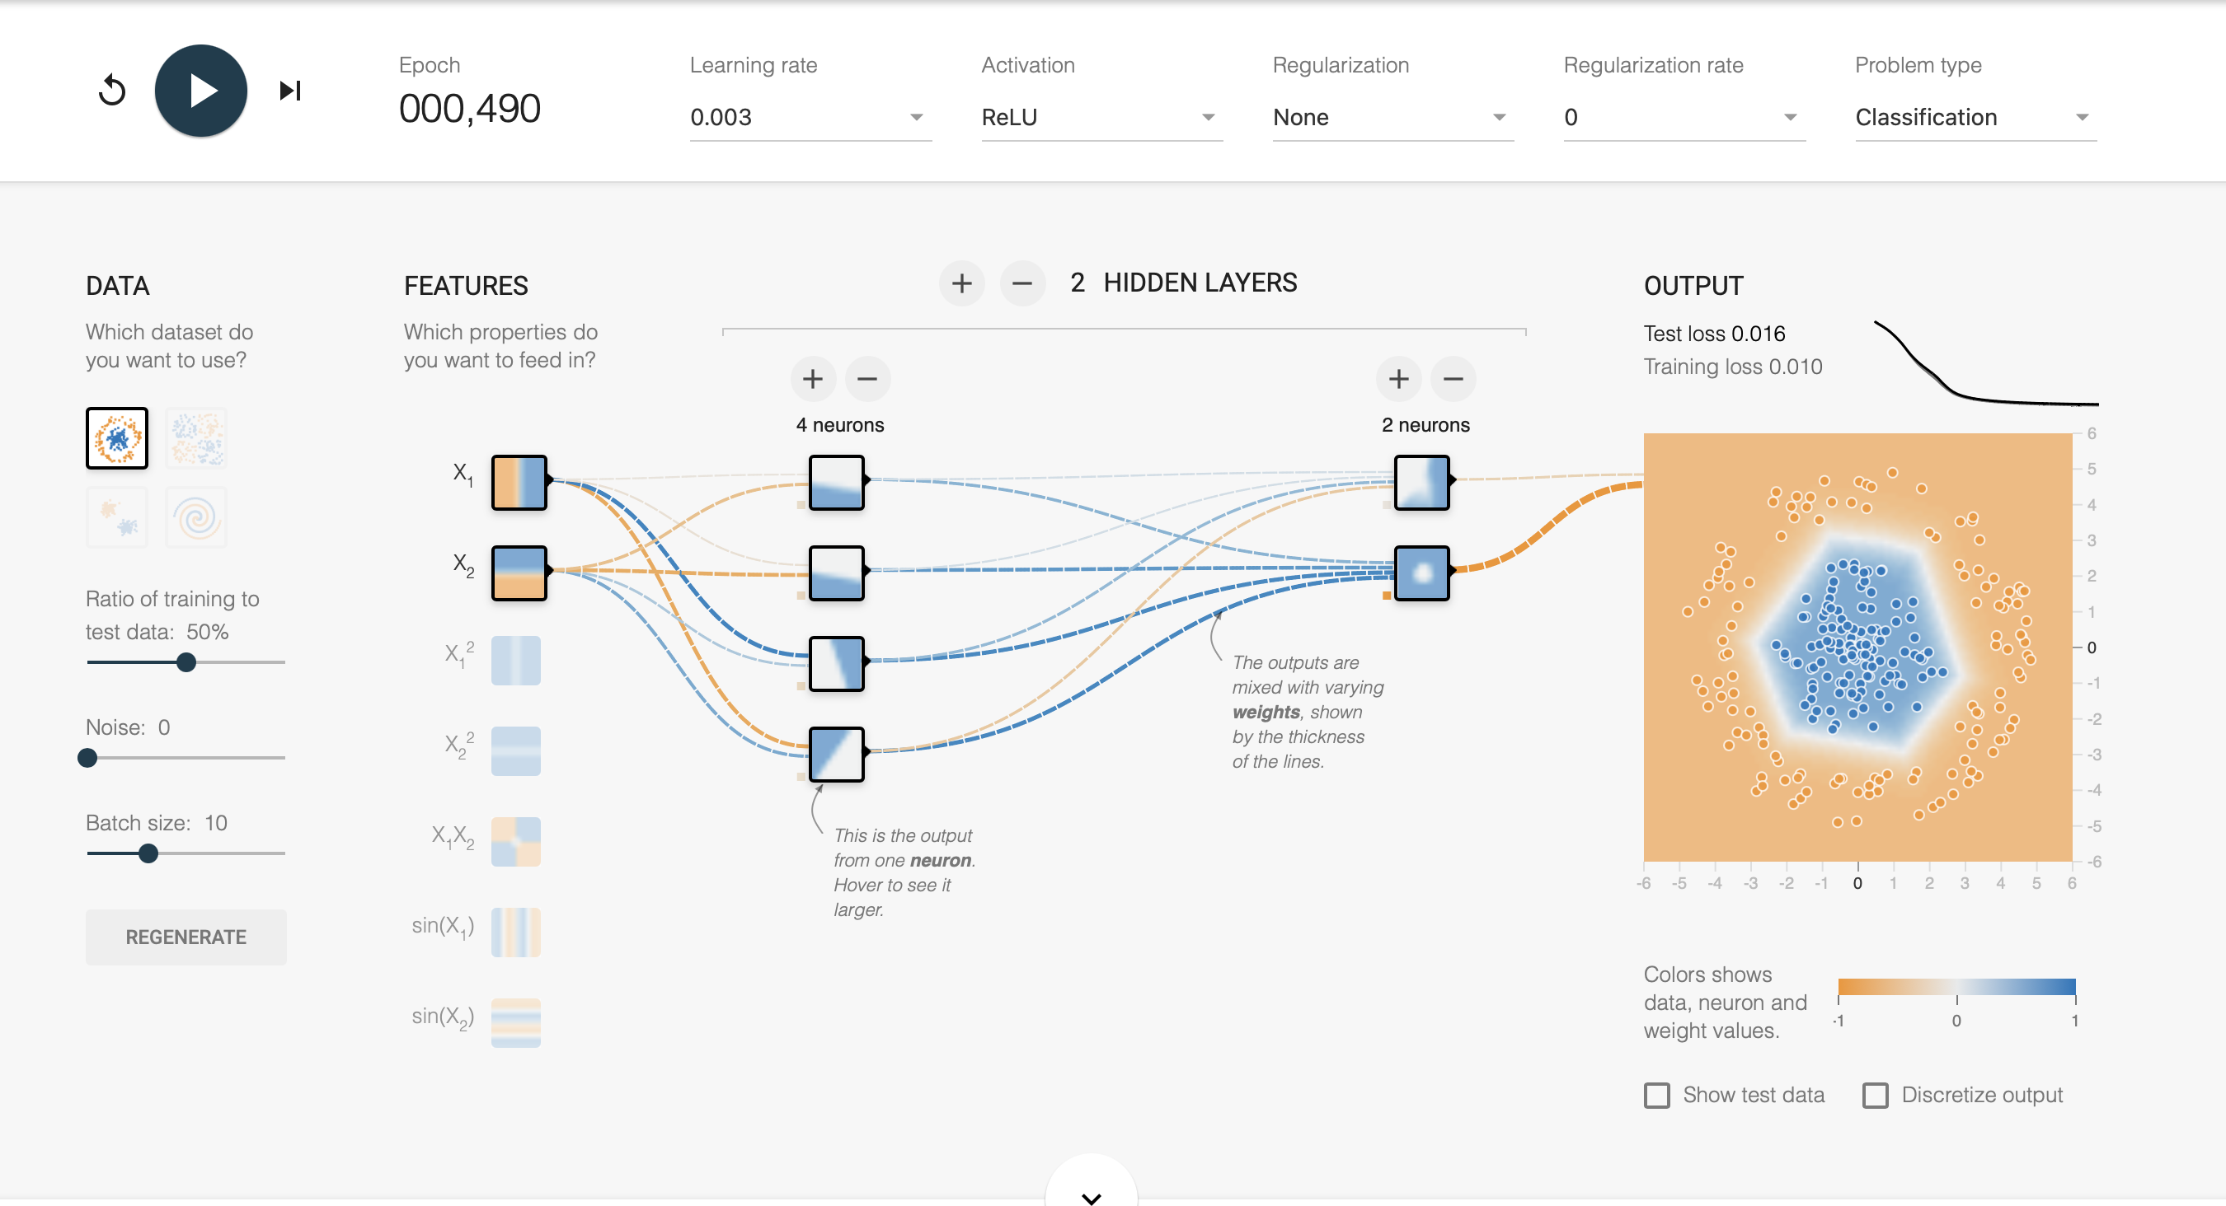
Hiperparametros: Epoch= 000.490 learning rate=0.003 Activation=Relu Regularization=none Regularization rate=0 Hidden layers= 2 1 hidden layers=4 2 hidden layers=2 Test los 0.016

Slide 6
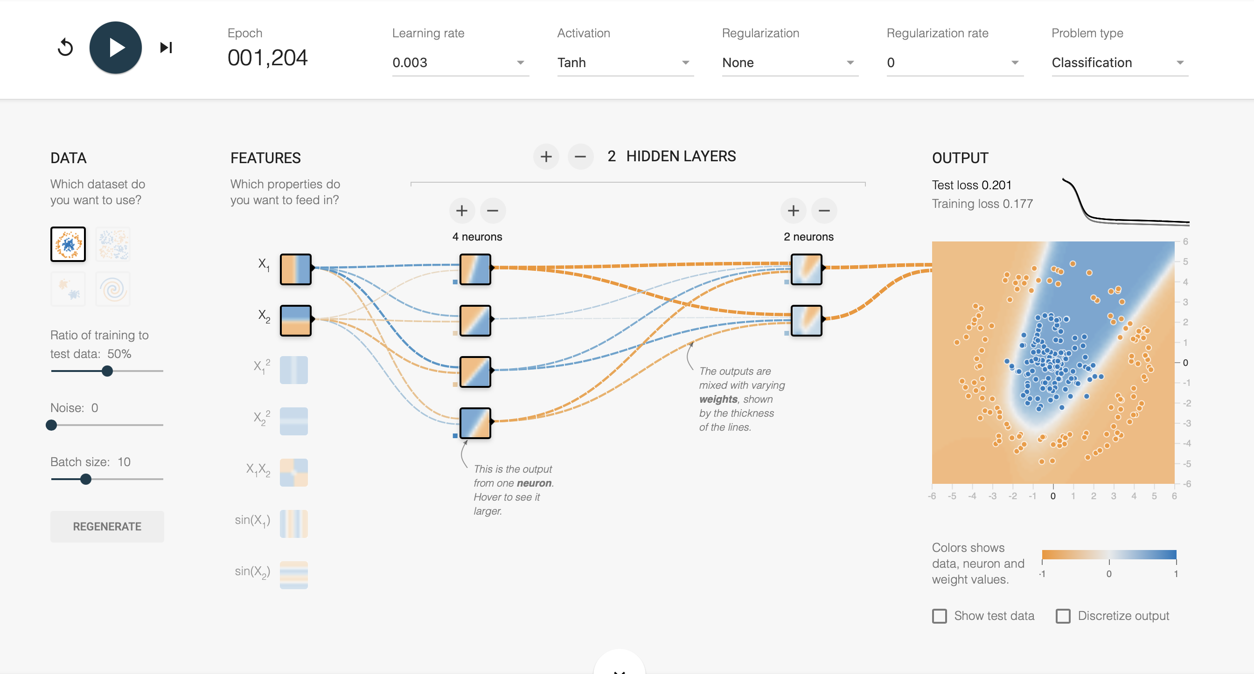
Hiperparametros: Epoch= 001204 learning rate=0.003 Activation=Tanh Regularization=none Regularization rate=0 Hidden layers= 2 1 hidden layers=4 2 hidden layers=2 Test los 0.201

Slide 7
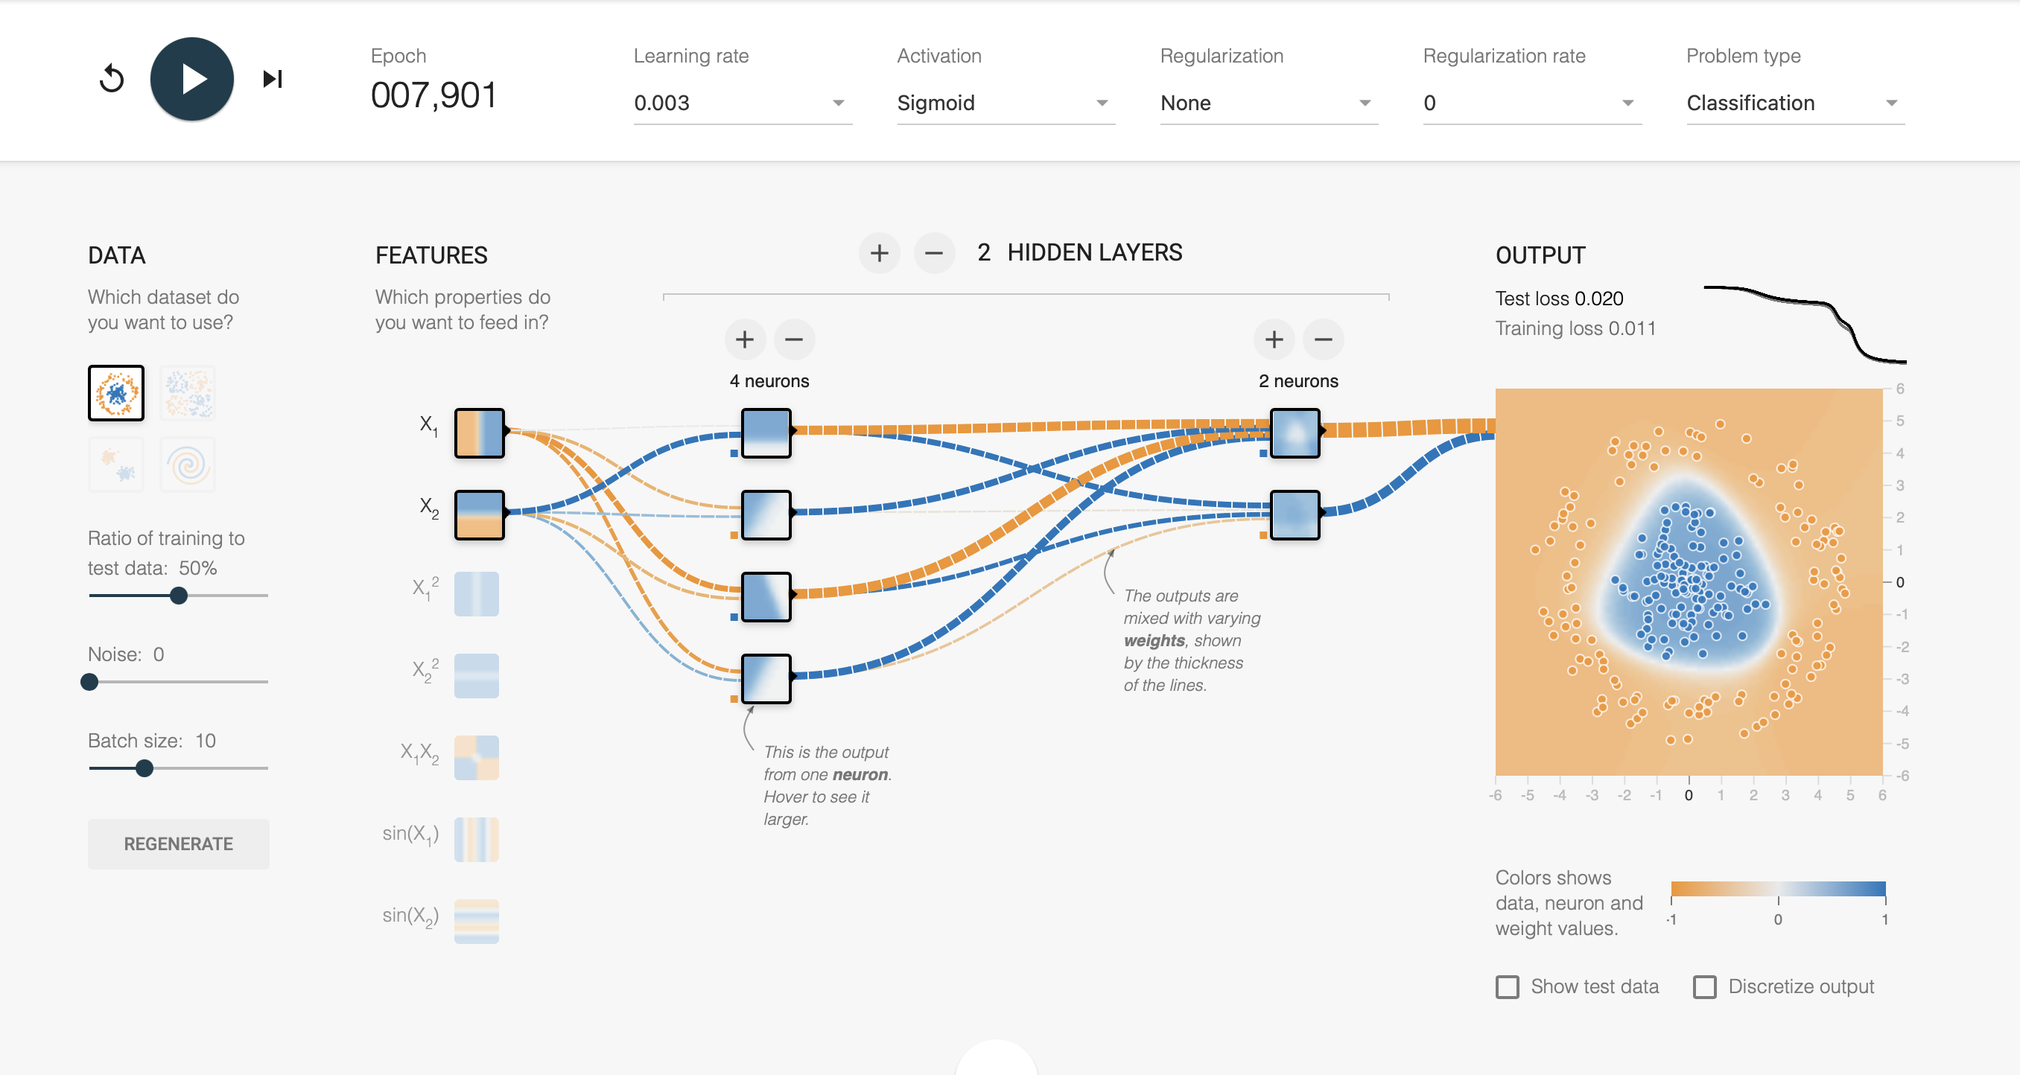
Hiperparametros: Epoch= 000.198 learning rate=0.003 Activation=Sigmoid Regularization=none Regularization rate=0 Hidden layers= 2 1 hidden layers=4 2 hidden layers=2 Test los 0.020

Slide 8
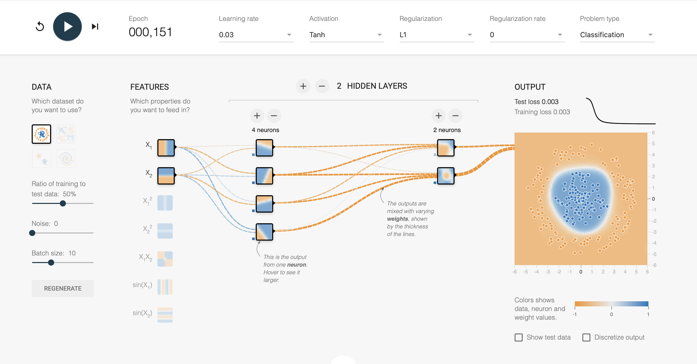
Hiperparametros: Epoch= 000.151 learning rate=0.03 Activation=Tanh Regularization=L1 Regularization rate=0 Hidden layers= 2 1 hidden layers=4 2 hidden layers=2 Test los 0.003

Slide 9
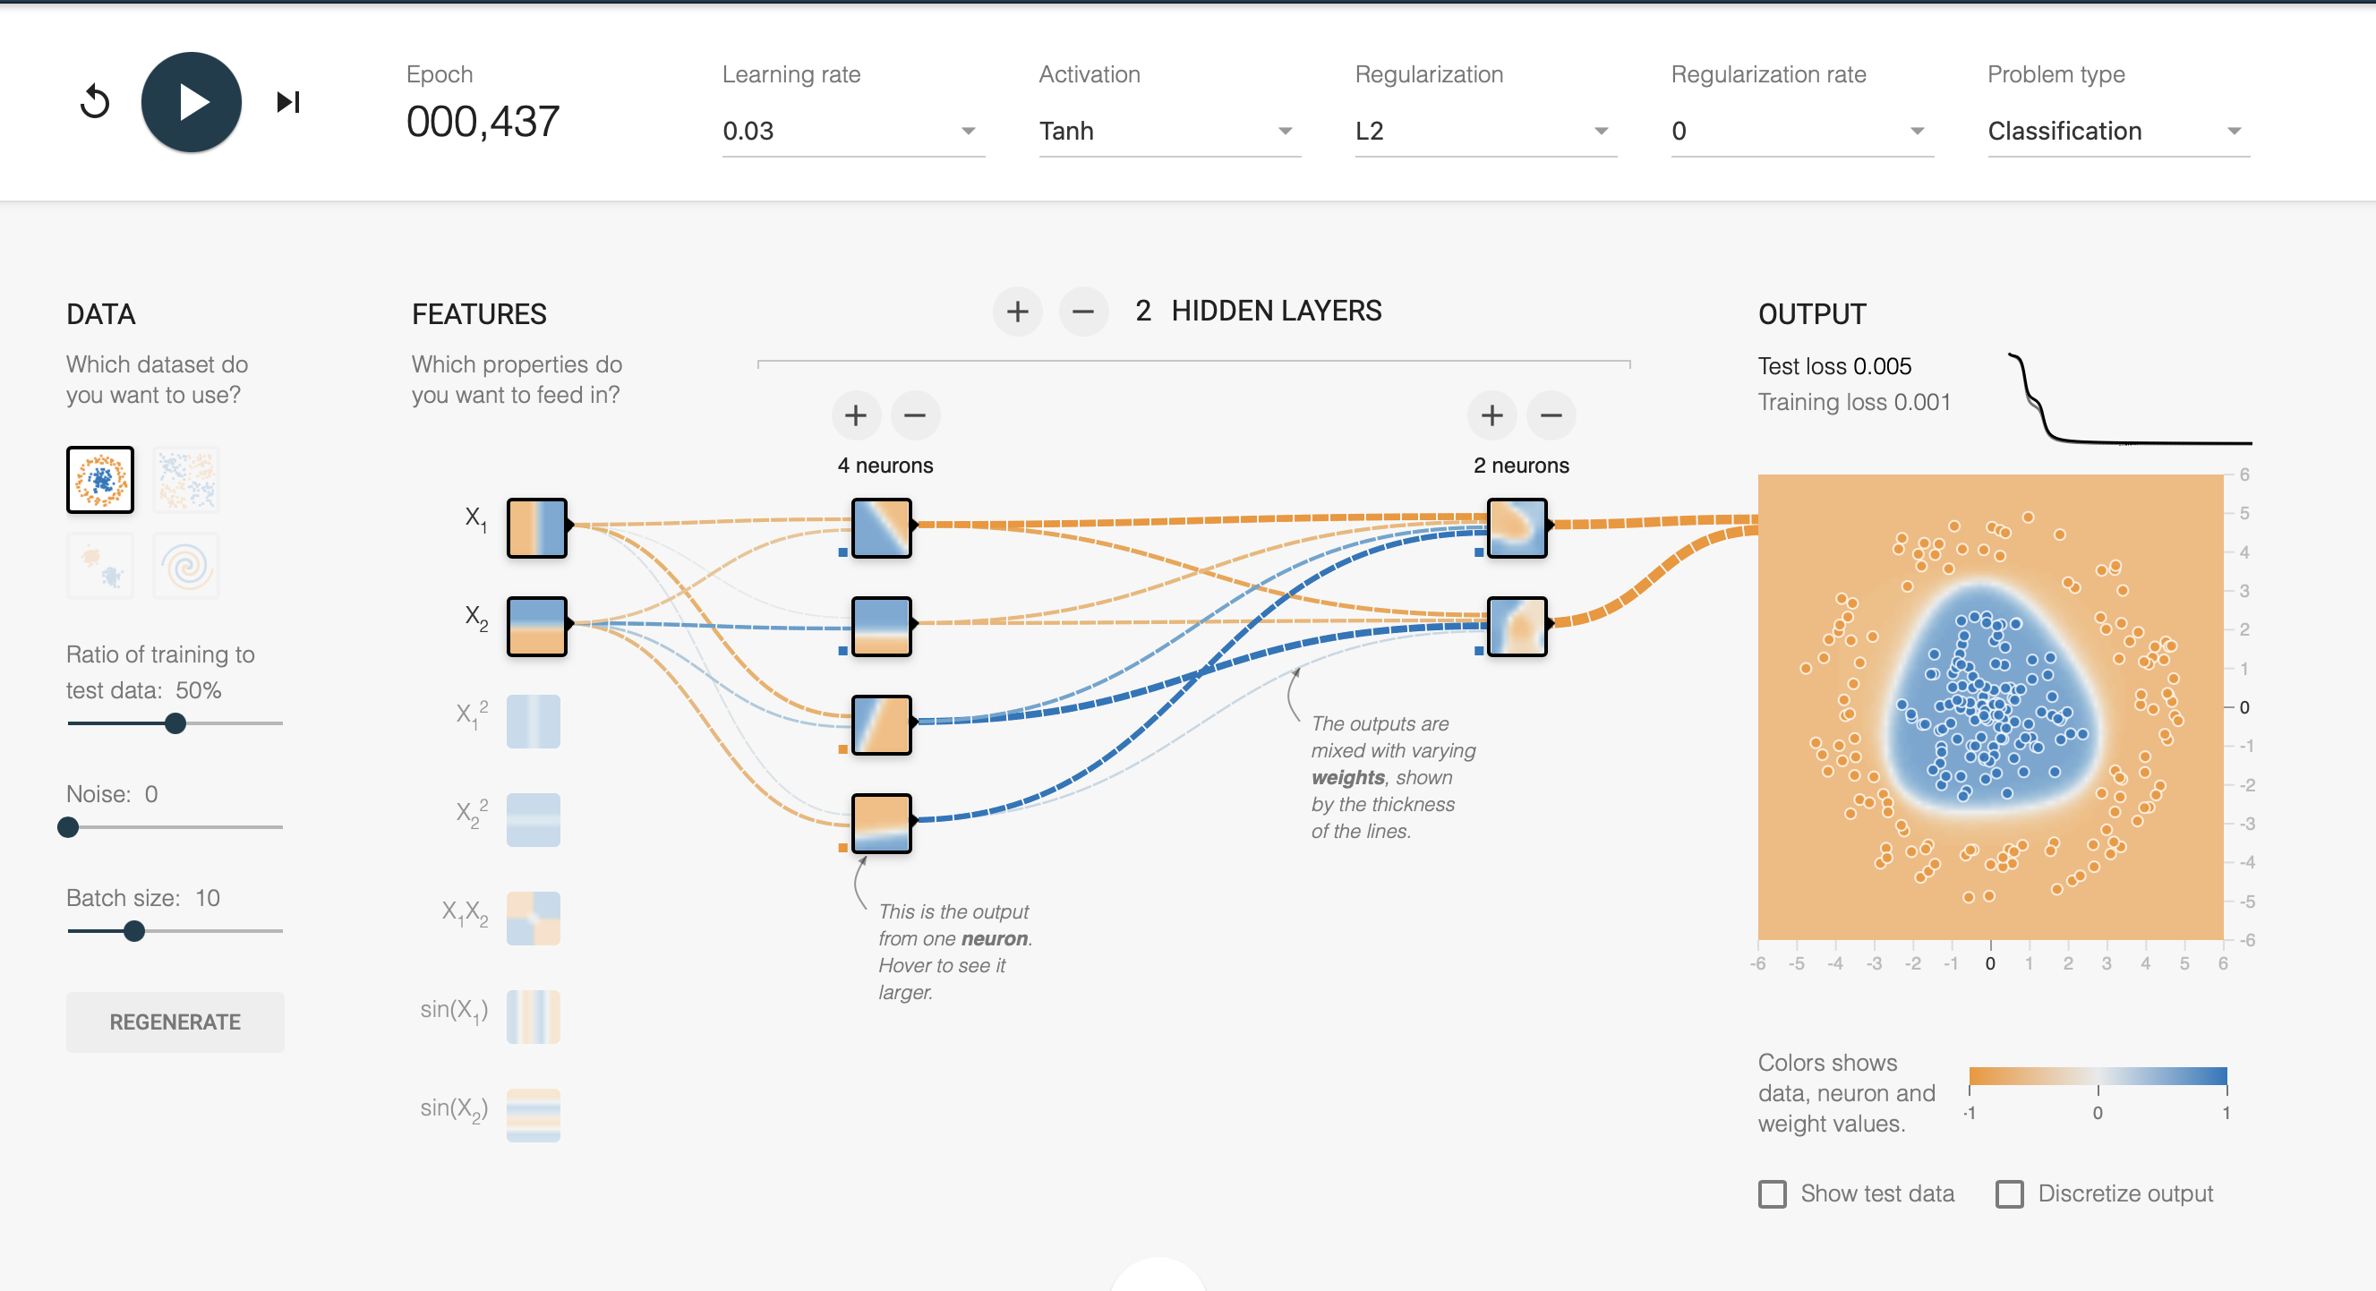
Hiperparametros: Epoch= 000.437 learning rate=0.03 Activation=Tanh Regularization=L2 Regularization rate=0 Hidden layers= 2 1 hidden layers=4 2 hidden layers=2 Test los 0.005

Slide 10
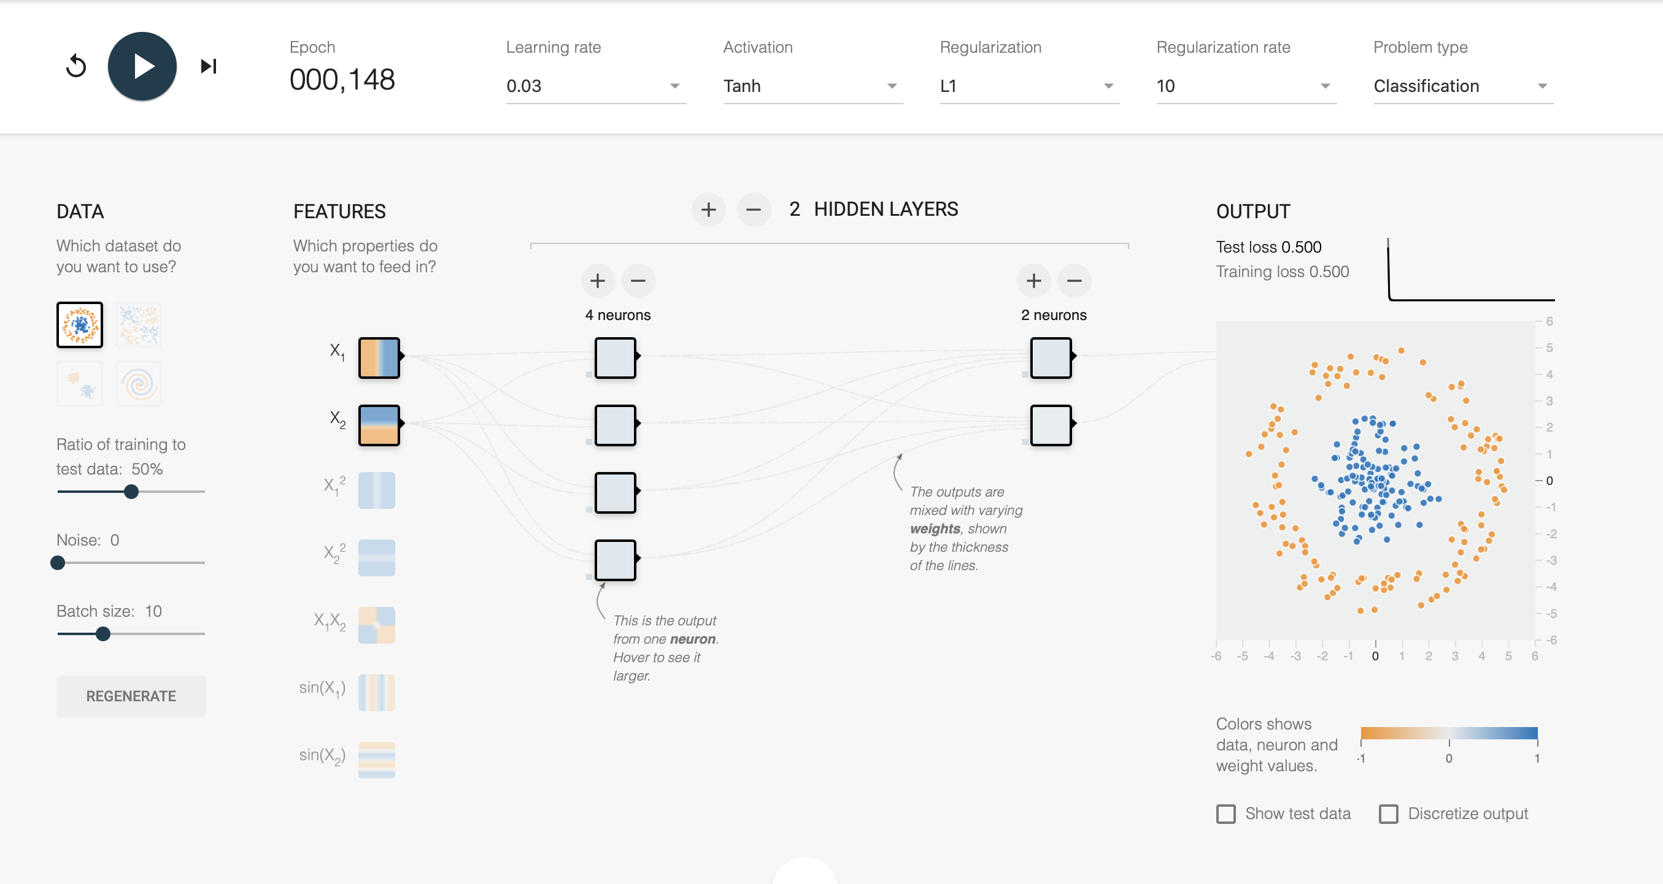
Hiperparametros: Epoch= 000.148 learning rate=0.03 Activation=Tanh Regularization=L1 Regularization rate=10 Hidden layers= 2 1 hidden layers=4 2 hidden layers=2 Test los 0.5

Slide 11
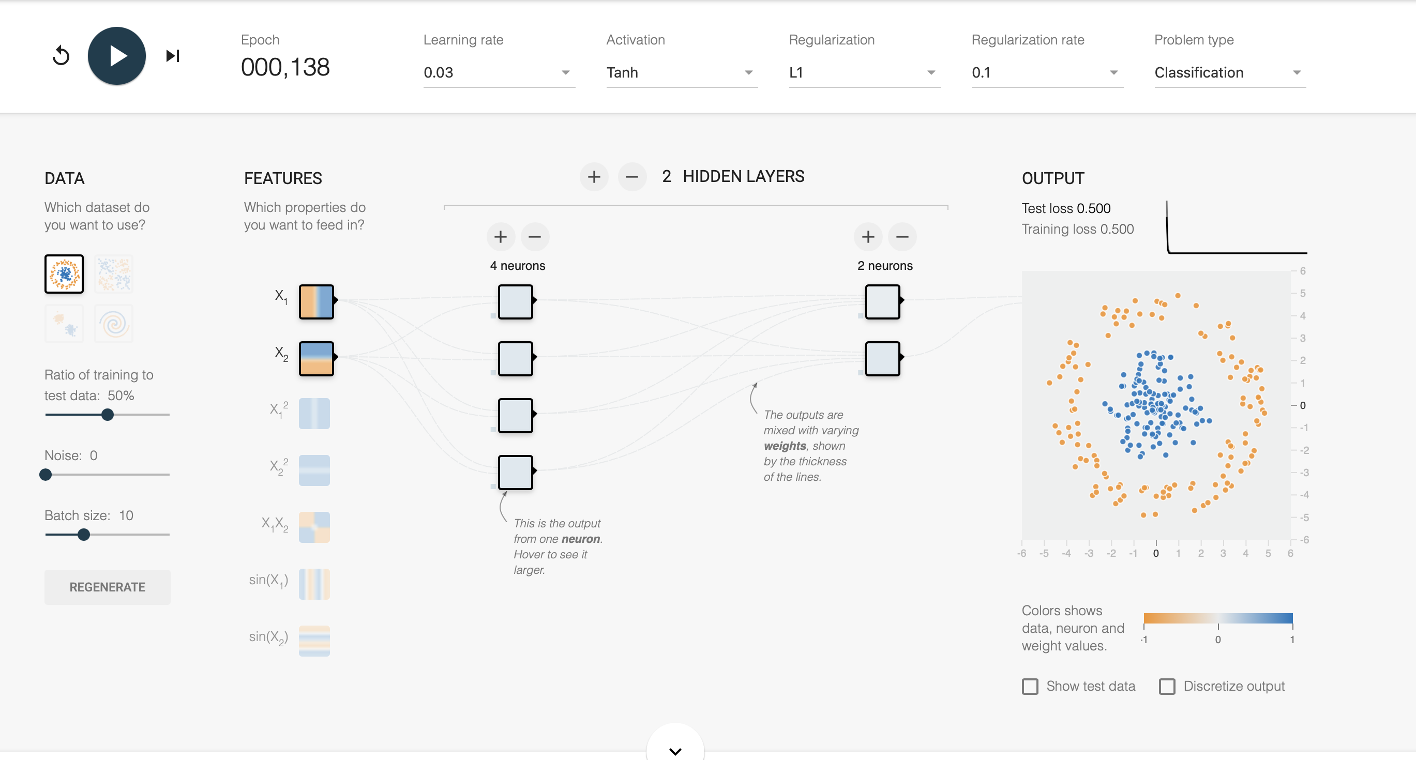
Hiperparametros: Epoch= 000.138 learning rate=0.03 Activation=Tanh Regularization=L1 Regularization rate=0.1 Hidden layers= 2 1 hidden layers=4 2 hidden layers=2 Test los 0.5

Slide 12
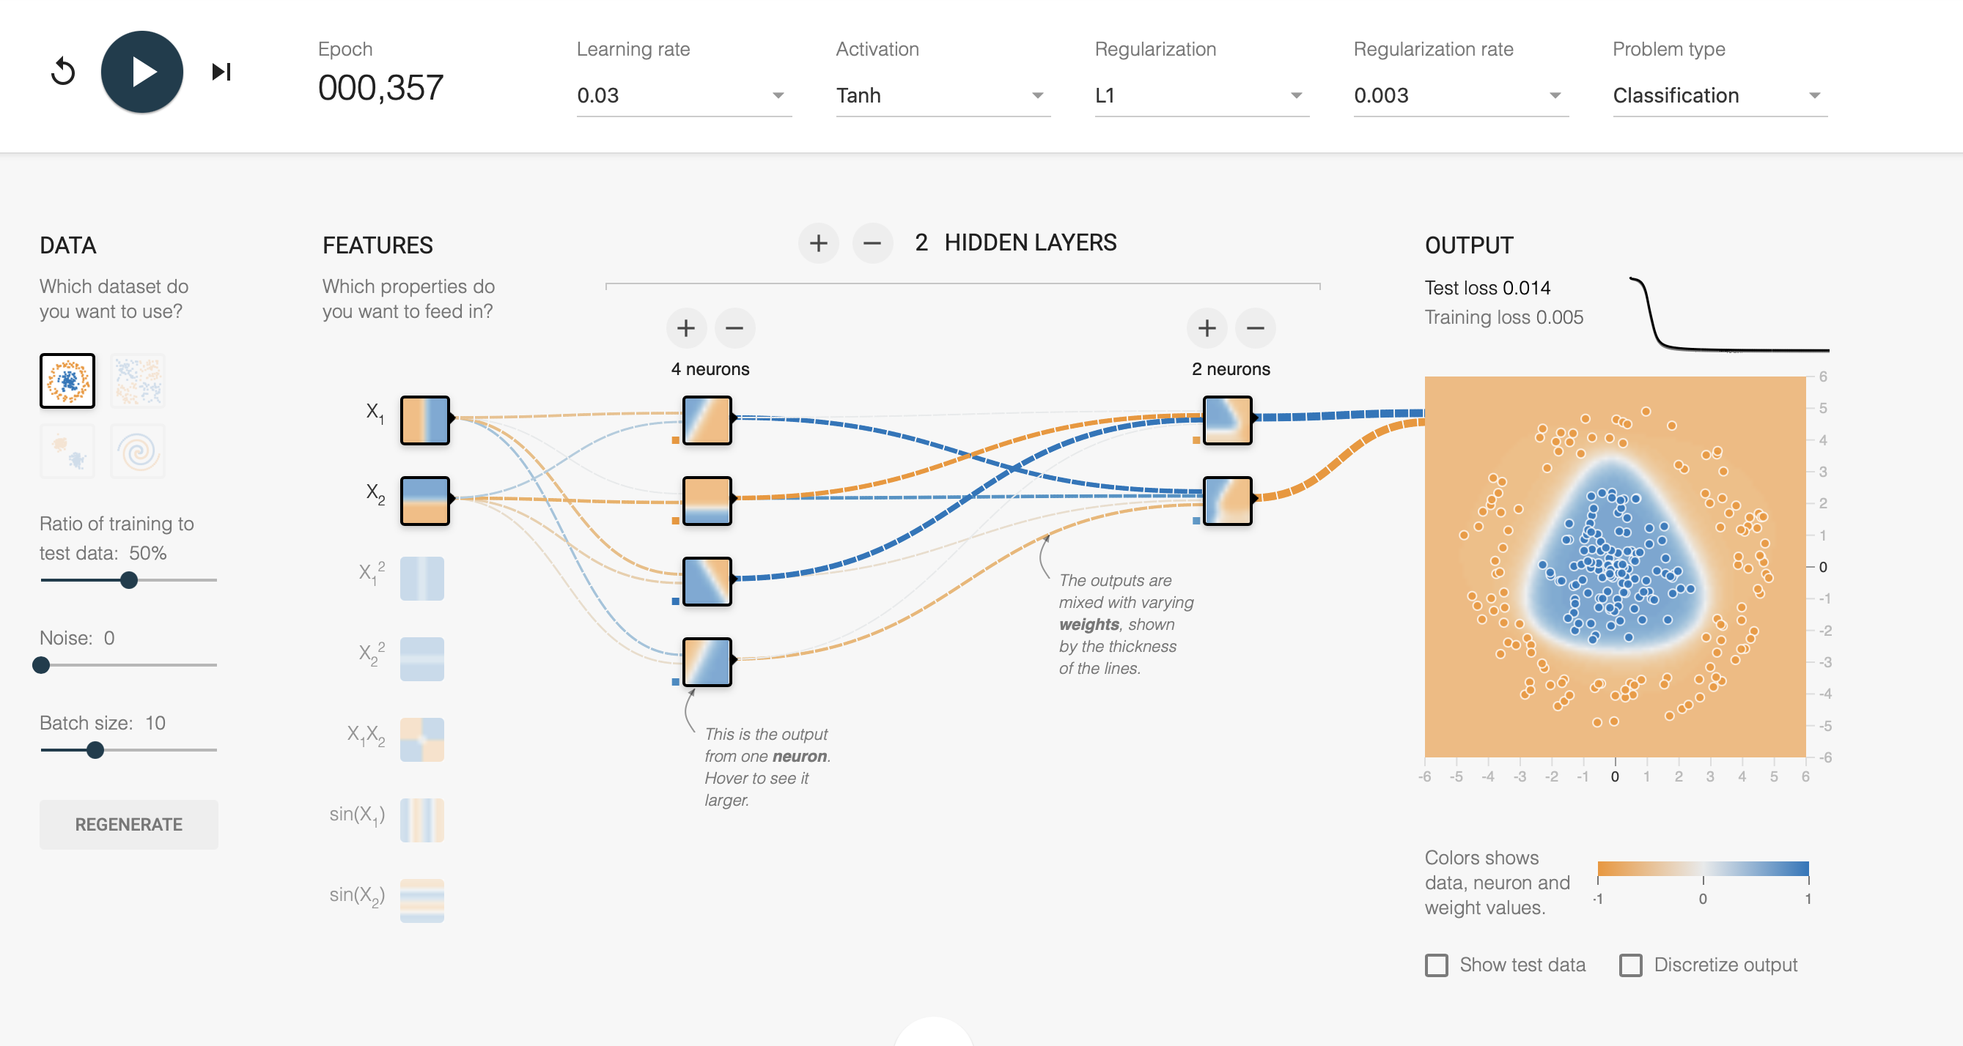
Hiperparametros: Epoch= 000.357 learning rate=0.03 Activation=Tanh Regularization=L1 Regularization rate=0.003 Hidden layers= 2 1 hidden layers=4 2 hidden layers=2 Test los 0.014

Slide 13
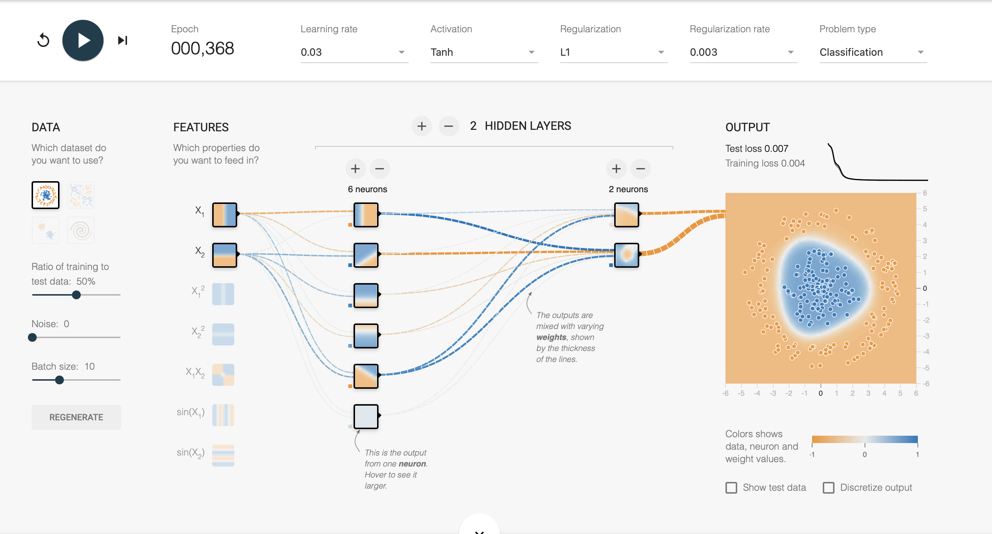
Hiperparametros: Epoch= 000.198 learning rate=0.03 Activation=Tanh Regularization=L1 Regularization rate=0.003 Hidden layers= 2 1 hidden layers=6 2 hidden layers=2 Test los 0.007

Slide 14
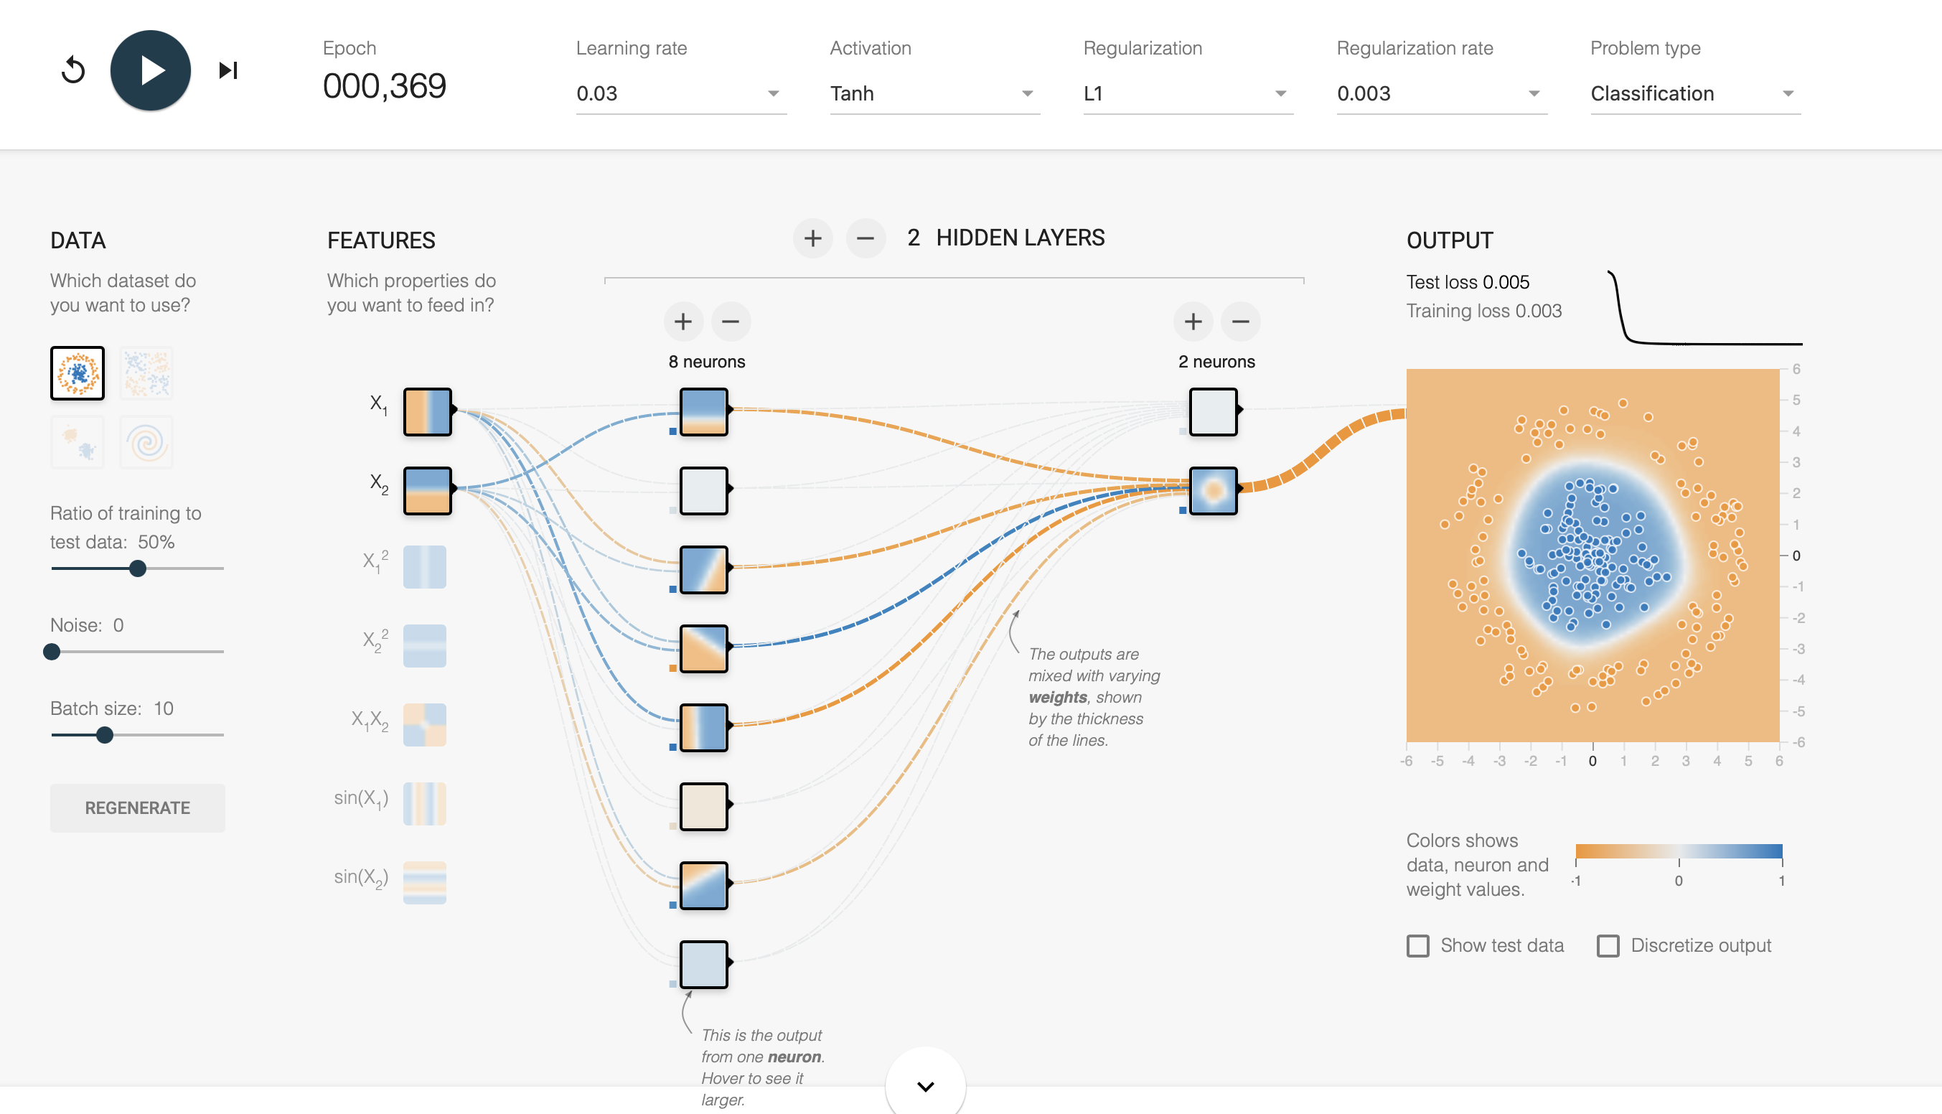
Hiperparametros: Epoch= 000.198 learning rate=0.03 Activation=Tanh Regularization=L1 Regularization rate=0.003 Hidden layers= 2 1 hidden layers=8 2 hidden layers=2 Test los 0.005

Slide 15
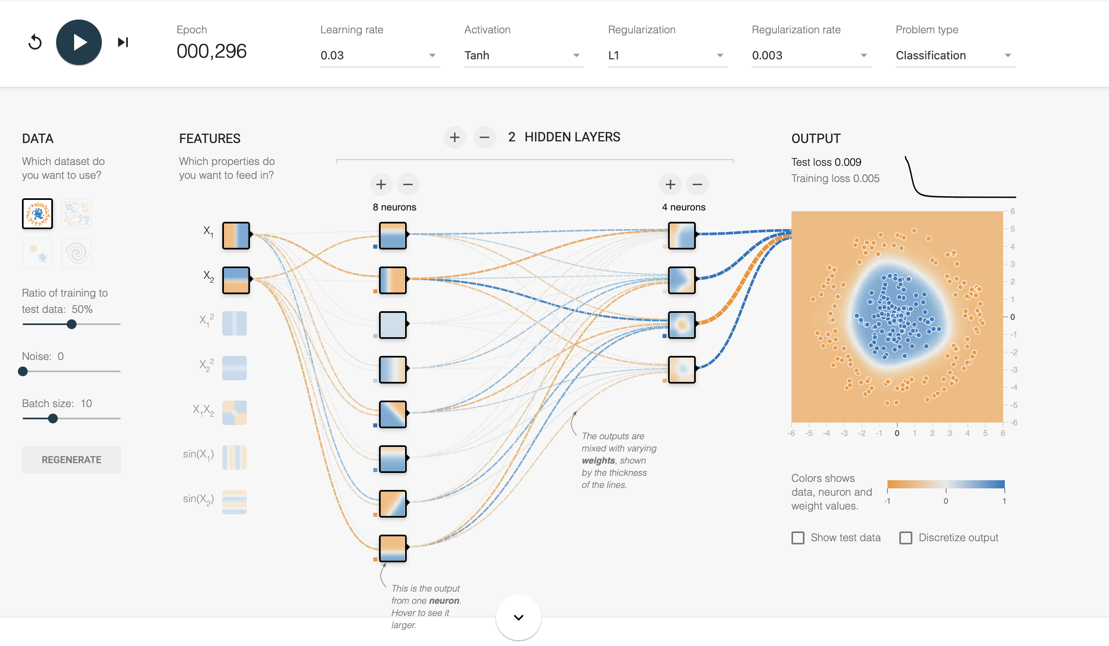
Hiperparametros: Epoch= 000.198 learning rate=0.03 Activation=Tanh Regularization=L1 Regularization rate=0.003 Hidden layers= 2 1 hidden layers=8 2 hidden layers=2 Test los 0.009

Slide 16
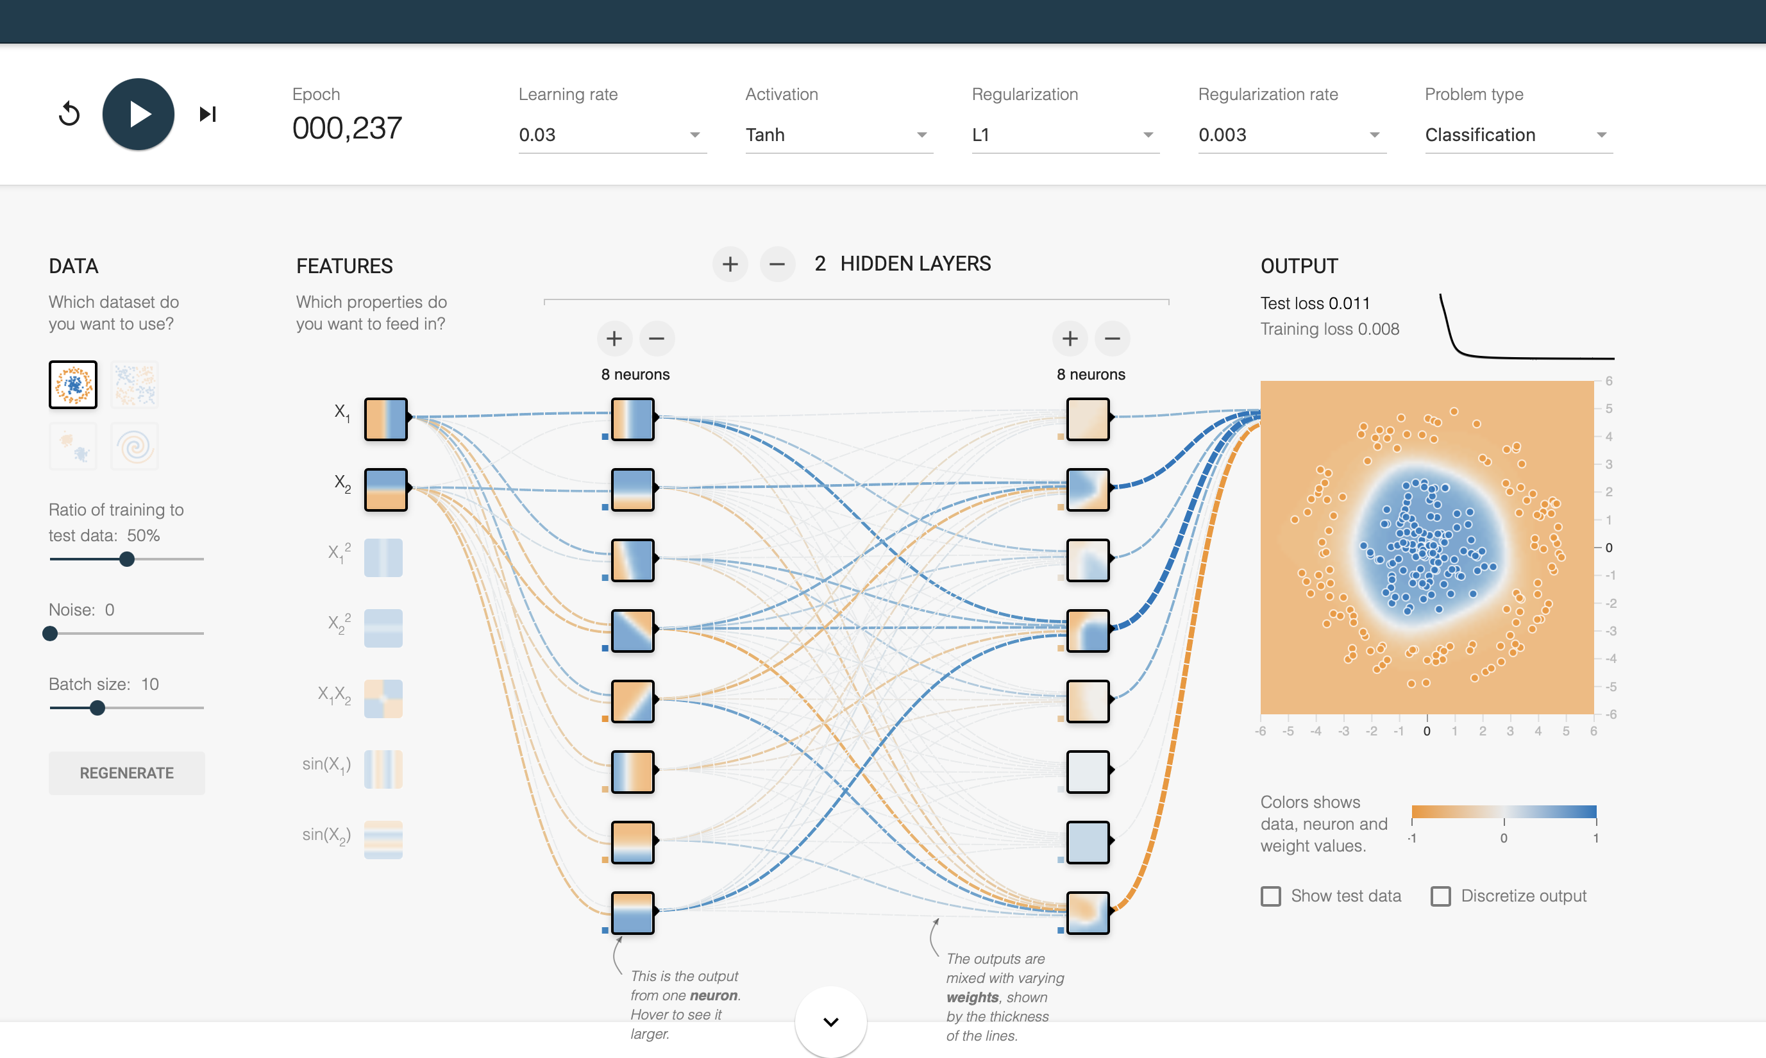
Hiperparametros: Epoch= 000.198 learning rate=0.03 Activation=Tanh Regularization=L1 Regularization rate=0.003 Hidden layers= 2 1 hidden layers=8 2 hidden layers=8 Test los 0.011

Slide 17
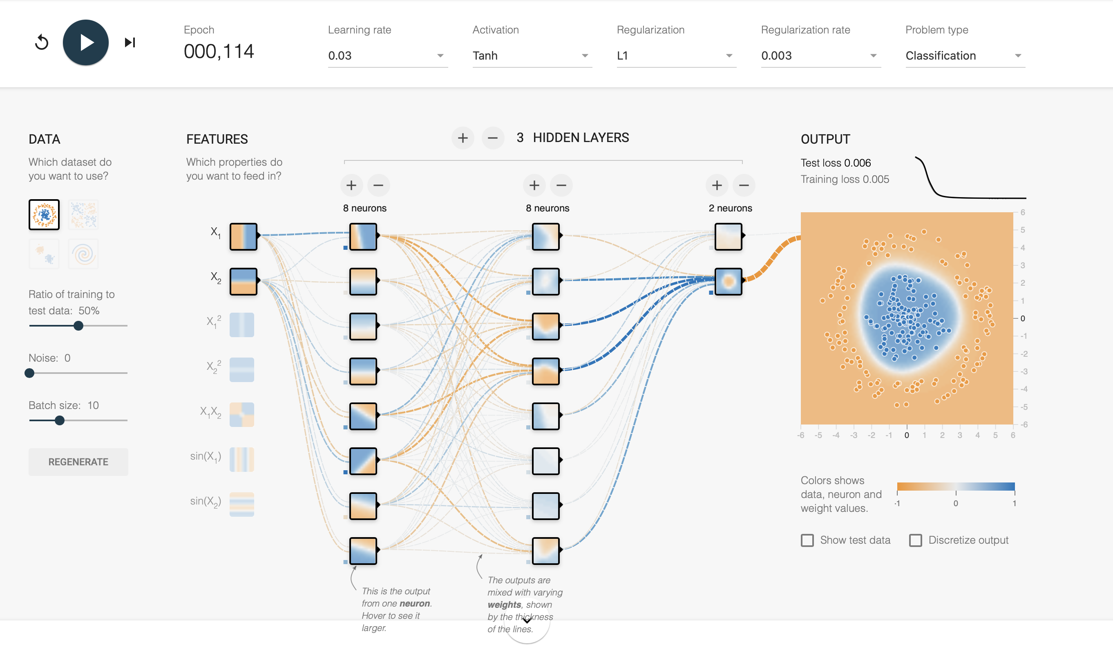
Hiperparametros: Epoch= 000.198 learning rate=0.03 Activation=Tanh Regularization=L1 Regularization rate=0.003 Hidden layers= 3 1 hidden layers=8 2 hidden layers=8 2 hidden layers=2 Test los 0.006

Slide 18
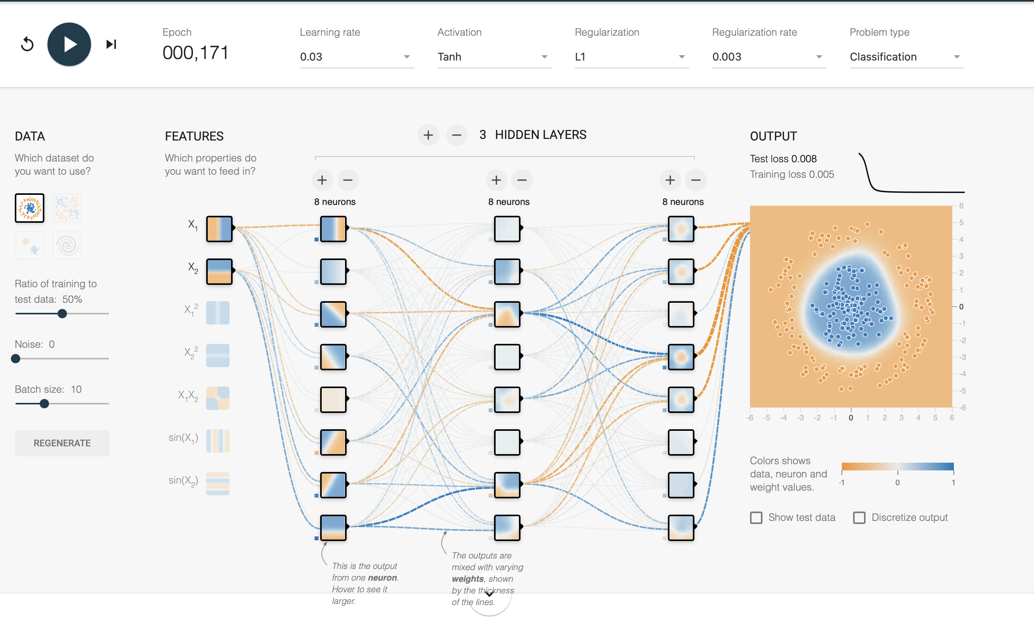
Hiperparametros: Epoch= 000.198 learning rate=0.03 Activation=Tanh Regularization=L1 Regularization rate=0.003 Hidden layers= 3 1 hidden layers=8 2 hidden layers=8 3 hidden layers=8 Test los 0.008

